Slide 1
Transnational Conference with Stakeholders and General Public
Foggia, 28.02.2025
PILOT ACTION
Municipality of Fasano
Municipality of Fasano, Giuseppe Pugliese

Slide 2
WP 2
Intermodal Pilot Actions
Activity 2.2
Pilot Actions: Multimodal Service Development in the different regions
Specific emphasis on fostering and demonstrate the feasibility of sustainable mobility options
A total of 6 pilot actions will be implemented – one for each municipality:
Fasano, Dugopolje, Centar Sarajevo Electric buses
Gjirokaster, and Budva Tuktuk for touristic purposes
Postojna Electric bicycles system
Start period: March 2026 – August 2026
End period: September 2026 – February 2027

Slide 3
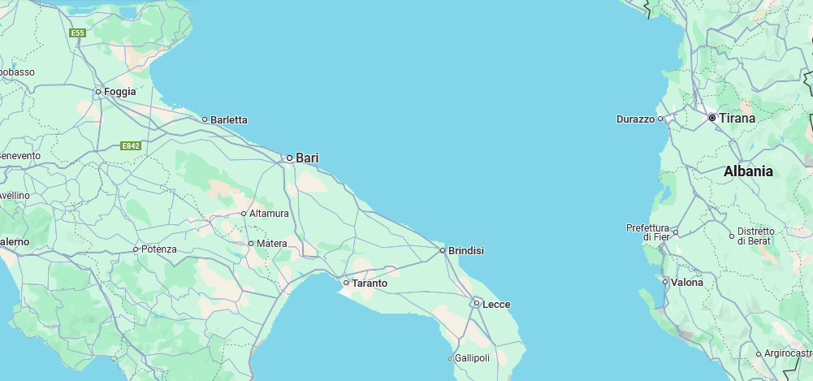
FASANO MUNICIPALITY - FIGURES AND DATA
Location – Strategic position
Central in Apulia region
About 50 km far from the large centres of Bari, Brindisi and Taranto
Reachable from two airports (Bari-Karol Wojtyla International Airport and Salento-Brindisi Airport)
Marks the border between the land of Bari (north west) and Salento (south east)
FASANO MUNICIPALITY

Slide 4
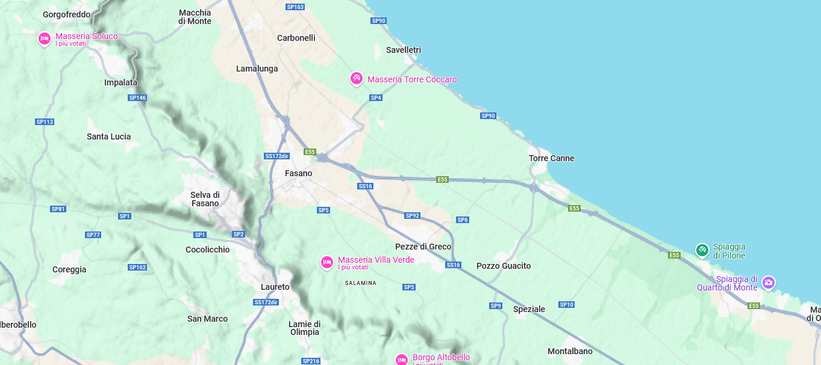
FASANO MUNICIPALITY - FIGURES AND DATA
The Land characteristics
Highly populated (40 k)
Fasano “city” (30 k)
Ten fractions and numerous districts
Little villages and scattered houses
Large Network of country roads
A wide plain mixing agrarian landscape and villages
Highly antropized
15 km of coastline
11 km Coast - Hills

Slide 5
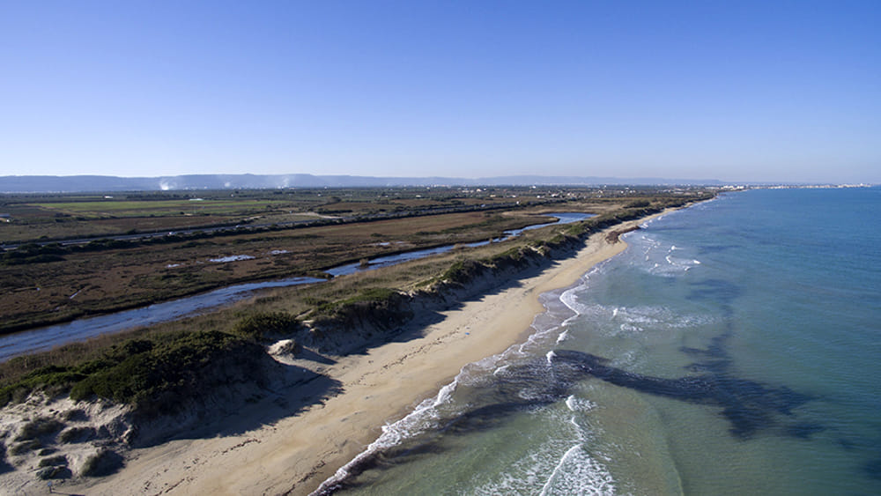
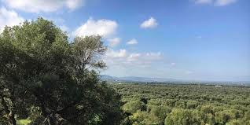
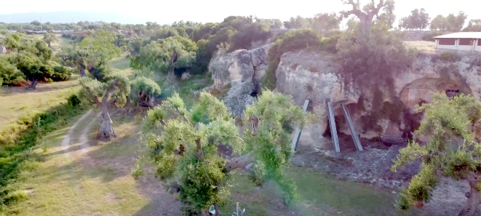
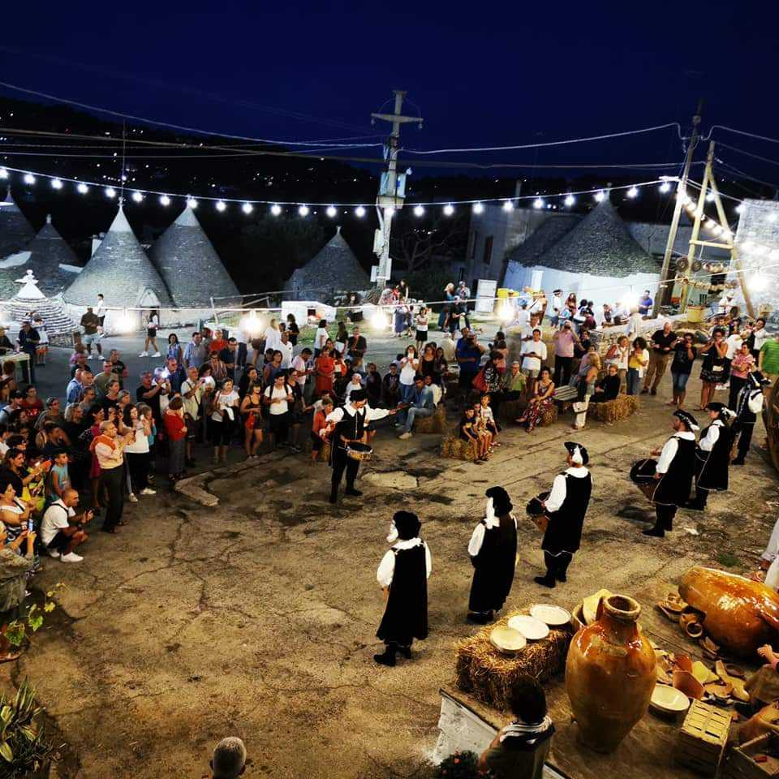
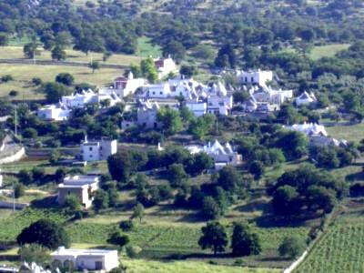
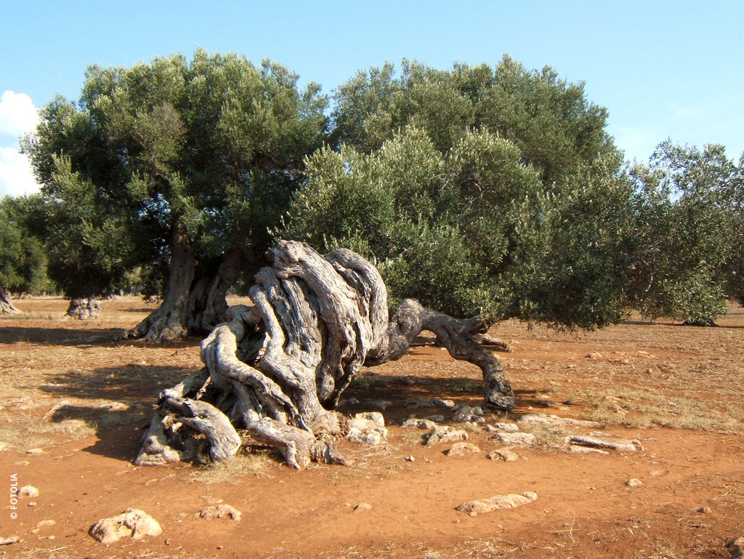
Attractiveness of Fasano Lands
The National Archaeological Museum of Egnazia
The Coastal Dunes Regional Natural Park
The Zoo Safari Park
The Lama D'Antico Rock Park
Strategic position, history, agriculture, landscapes, gastronomy, folklore, popular traditions …
… just some of the many aspects that have made the Lands of Fasano one of the most visited destinations by travellers from all over the world.

Slide 6
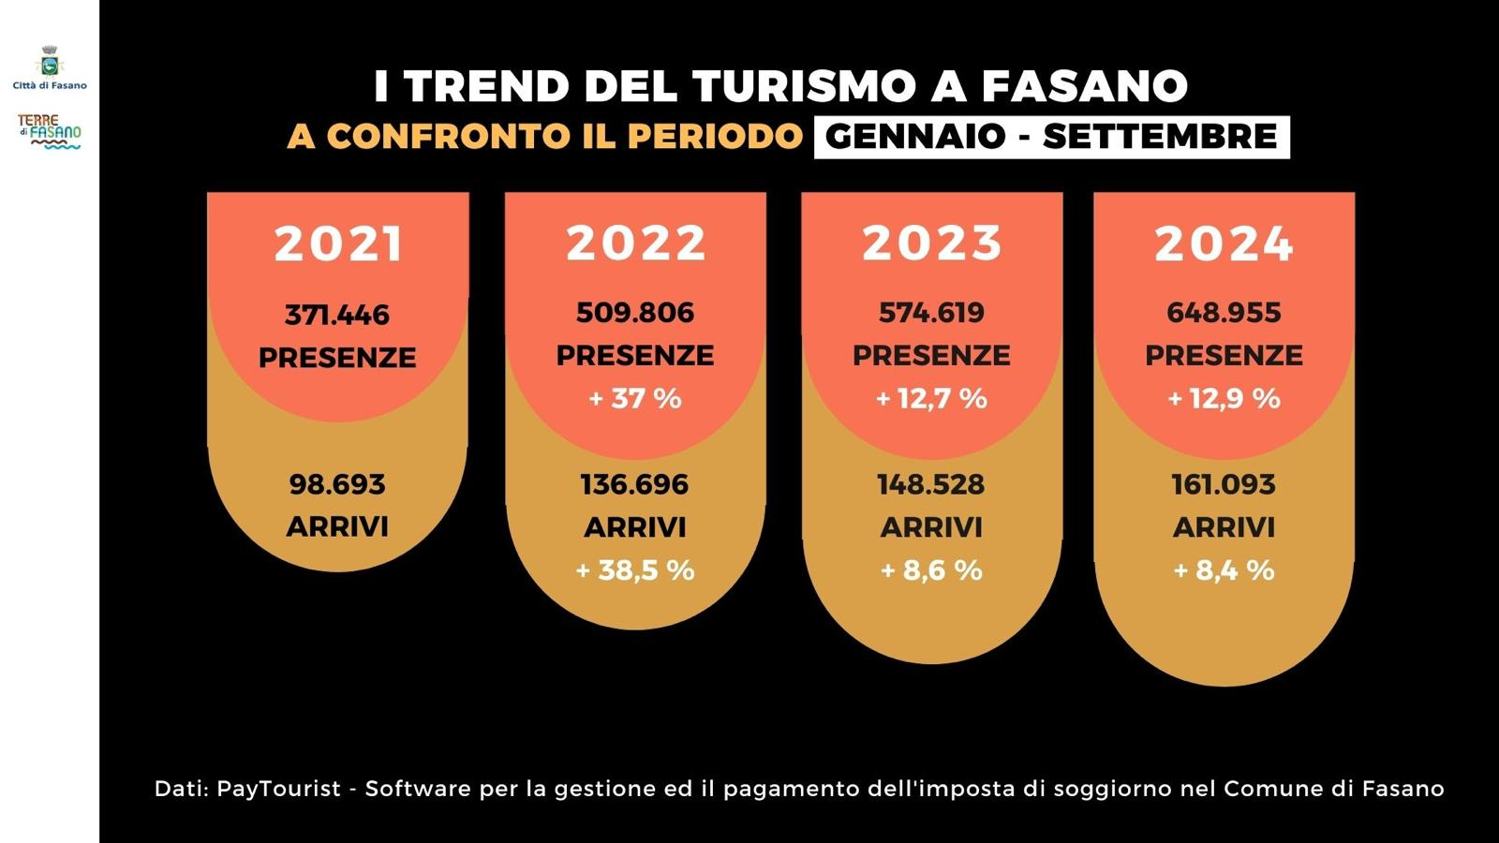
Recent trends in tourism reveal a strong continuous growth

Slide 7
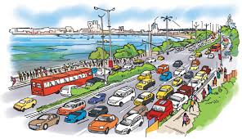
IMPACTS - Problems to be faced
Environmental pressure (water, garbage, soil and air pollution)
Traffic congestion (especially in summer season)
Huge number of residents’ private cars
Growth of rental cars
Weakness about tourist logistic
Many tourists attractions are far apart from each other, scattered throughout the area
Public transport service covers only main itineraries, connecting villages to the city

Slide 8
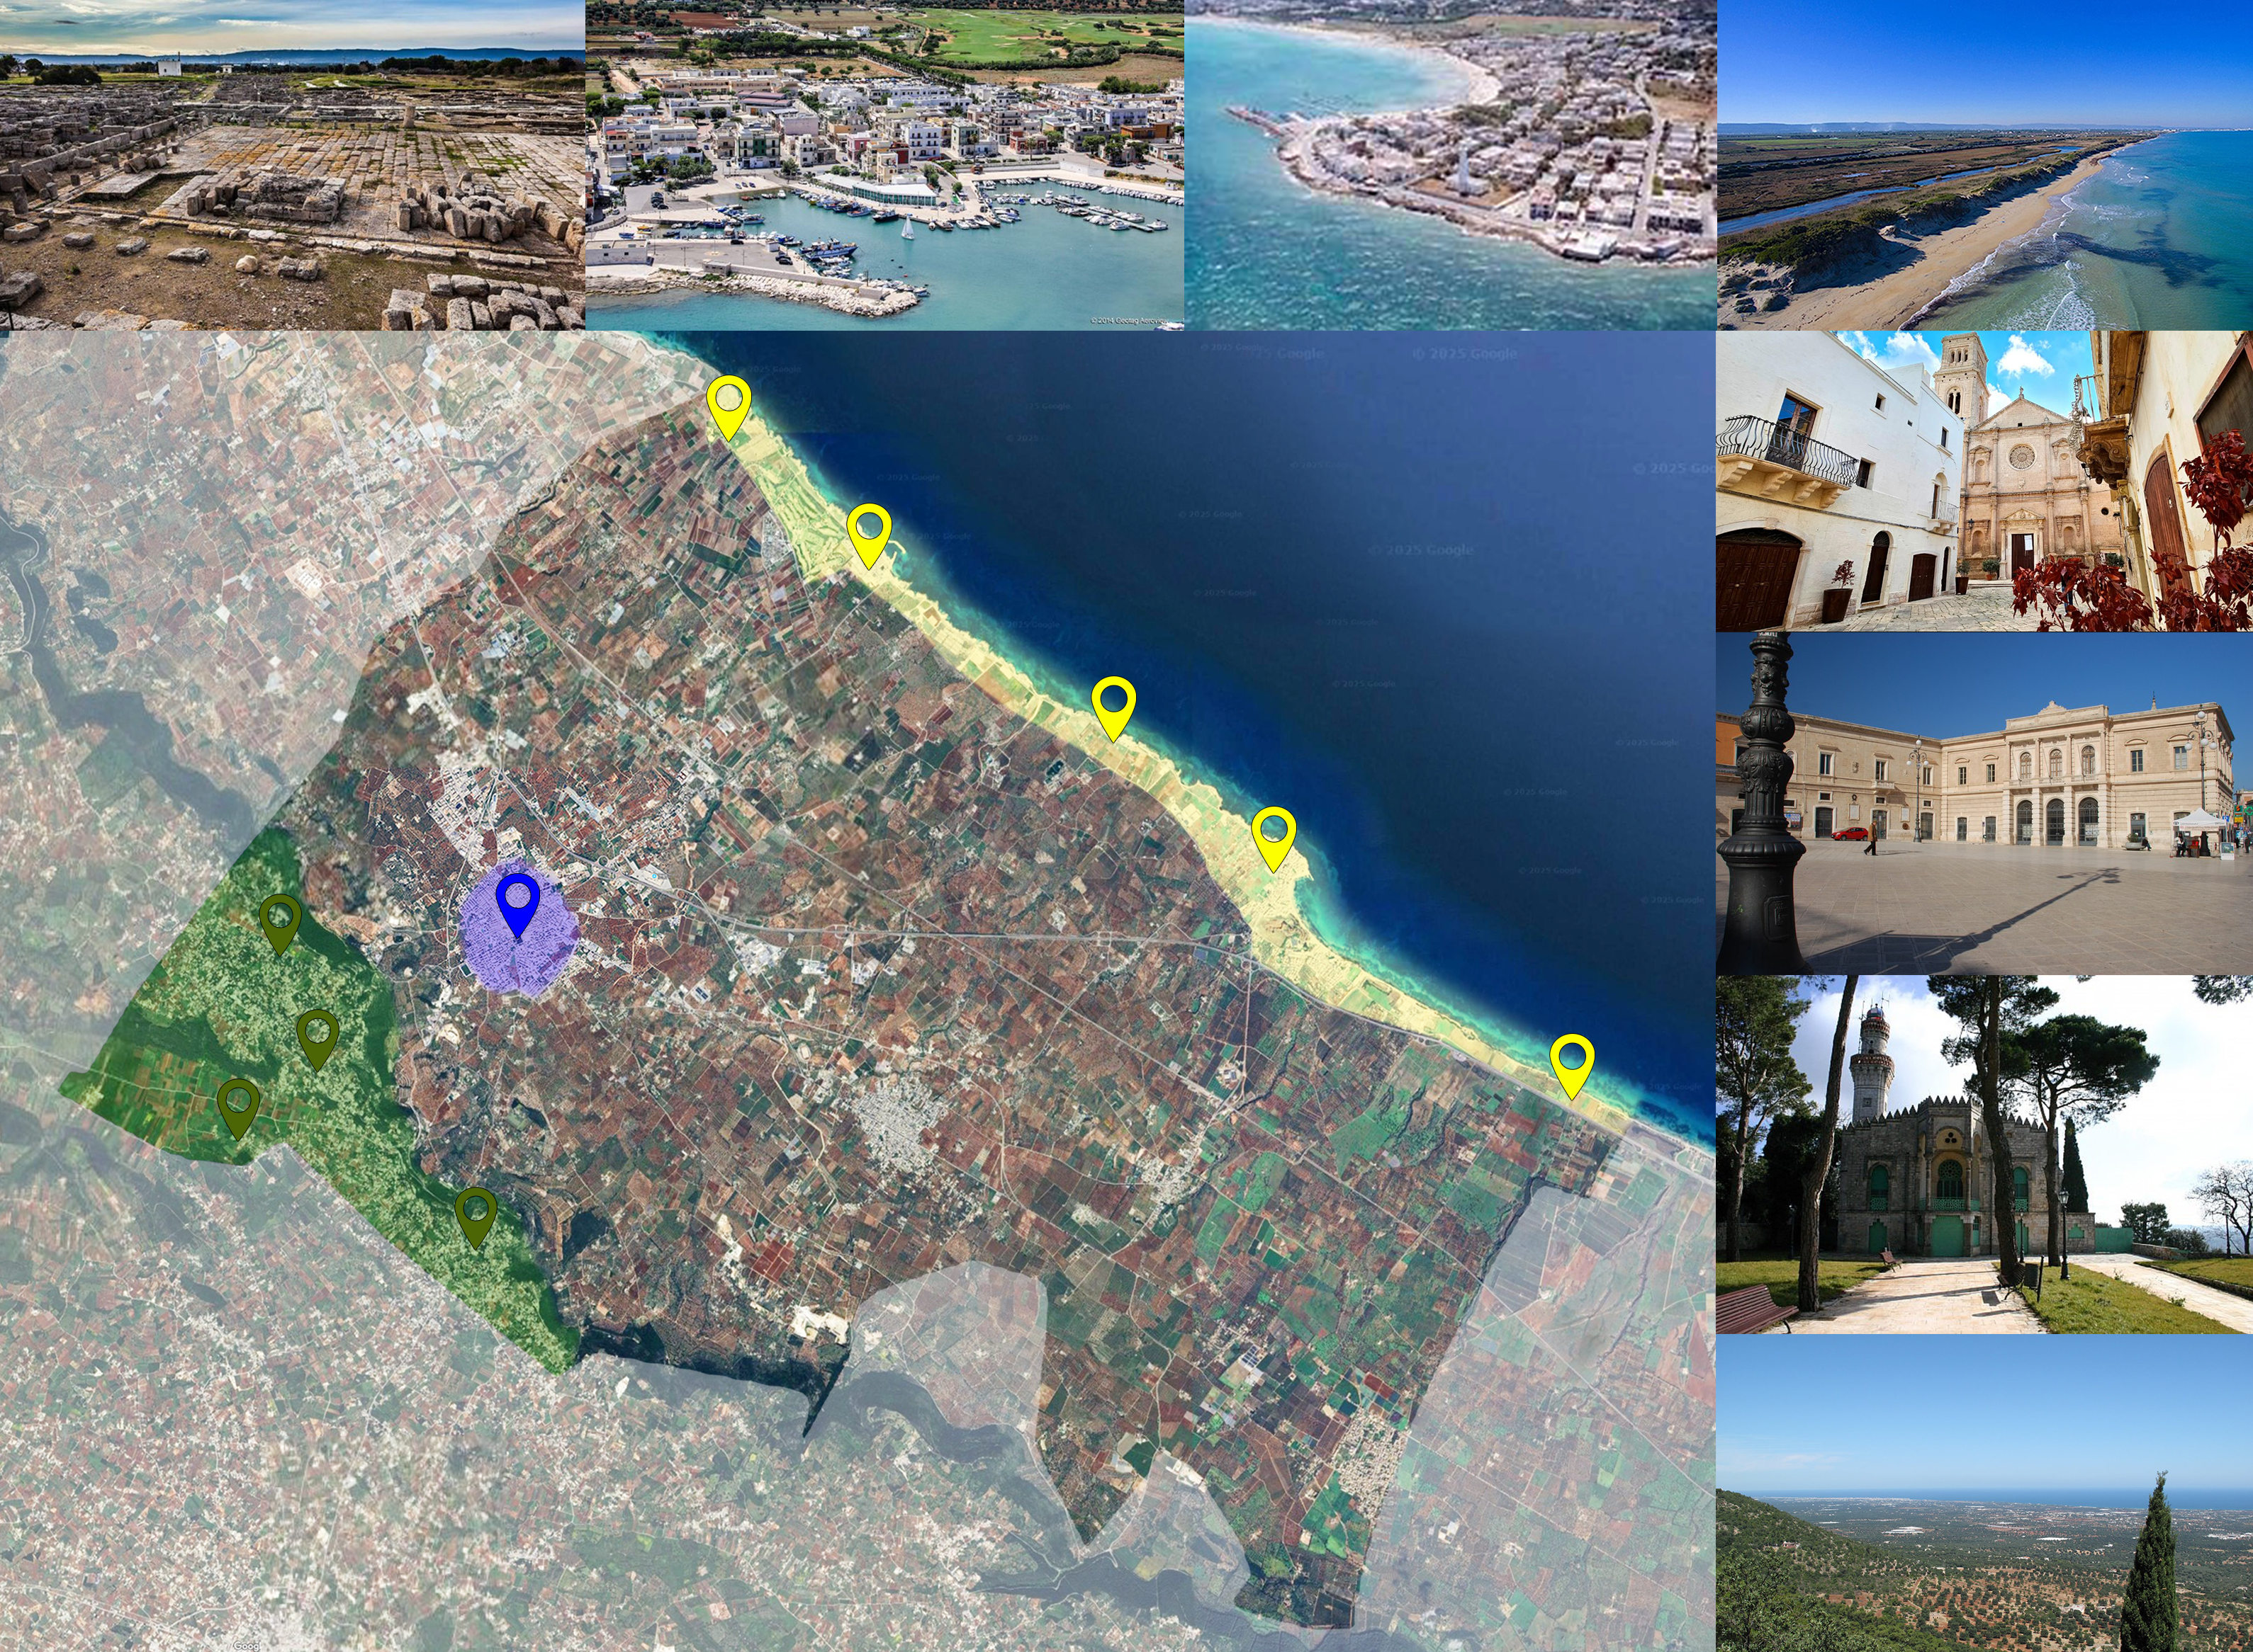

Slide 9
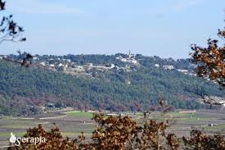
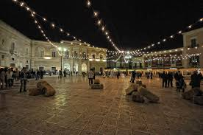
PILOT ACTION IDEA – Fasano (IT)
CONNECTING MAIN TOURIST ATTRACTIONS
BY ELECTRIC VAN FOR COLLECTIVE TRANSPORT
Drawing 3 ITINERARIES scheduled in 3 shifts
HILLS area in the morning
COASTLINE in the afternoon
FASANO town and main fractions by night

Slide 10
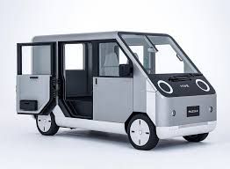
PILOT ACTION IDEA – Fasano (IT)
CONNECTING MAIN TOURIST ATTRACTIONS
BY ELECTRIC VAN FOR COLLECTIVE TRANSPORT
HOW WILL BE MANAGED:
BOOKING by single tourist / tourist facilities (hotels, agencies, etc.)
MANAGED by Info Points (Fasano city, Torre Canne and Savelletri)
Agreement with a transport service agency (driving)
PERIOD: 2 / 3 MONTHS - MAY – JULY 2026

Slide 11
Thank you!
28/02/2025
by Giuseppe Pugliese
Lead Partner Municipality of FASANO

